Slide 1
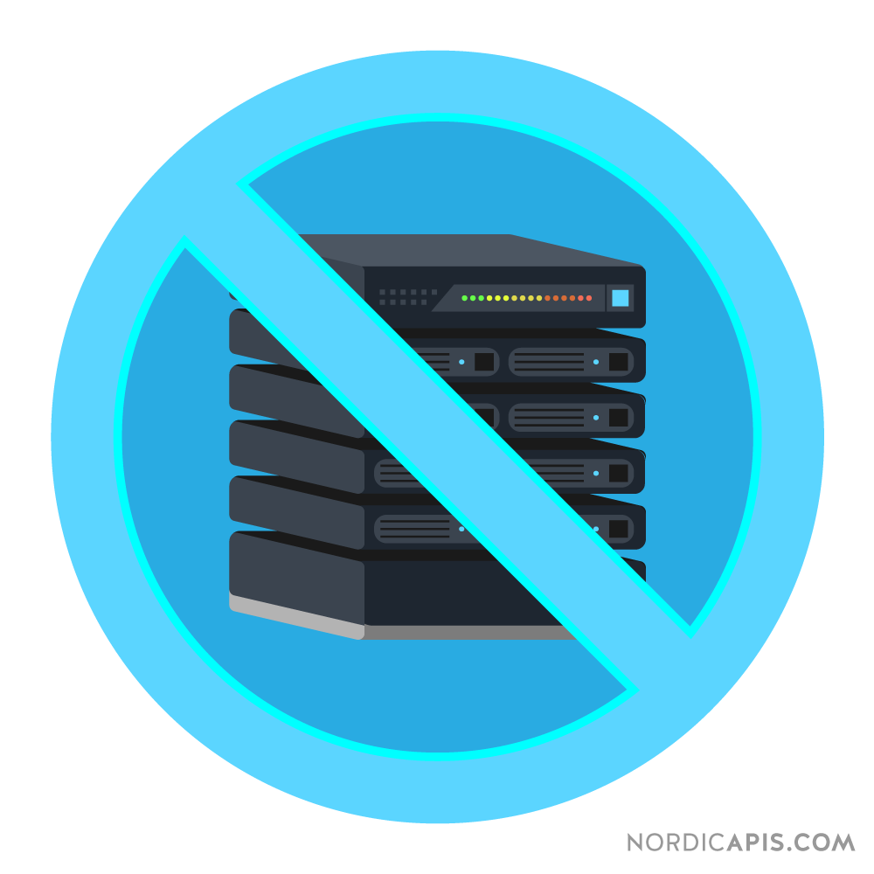
Serverless

Slide 2





Slide 3
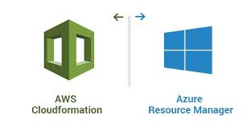


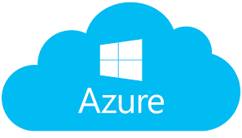


Slide 4
What is Serverless?
A category of cloud computing services that provides a platform allowing customers to develop, run, and manage application without the complexity of building and maintaining the infrastructure typically associated with developing and launching an app.
Notes:
A serverless architecture approach replaces long running virtual machines with ephemeral compute power that comes into existence on request and disappears immediately after use.

Slide 5
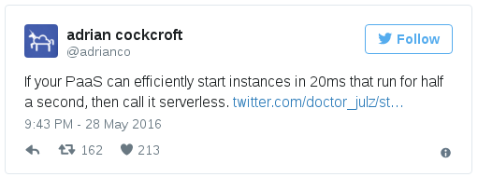
Functions As A Service
FaaS platforms lets you deploy and invoke ephemeral function processes to handle individual requests

Slide 6
Benefits of Serverless
Scalability
Reduced Operational Cost
Less Ops (?)
Greener Computing
The key operational difference between FaaS and PaaS is scaling. With most PaaS’s you still need to think about scale,

Slide 7
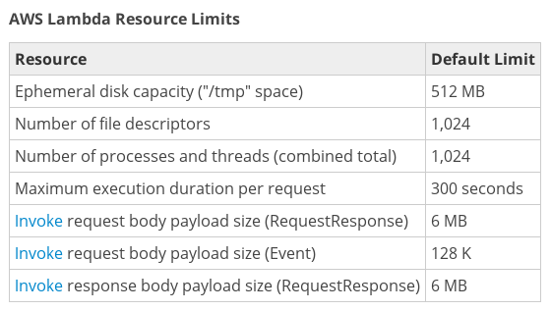
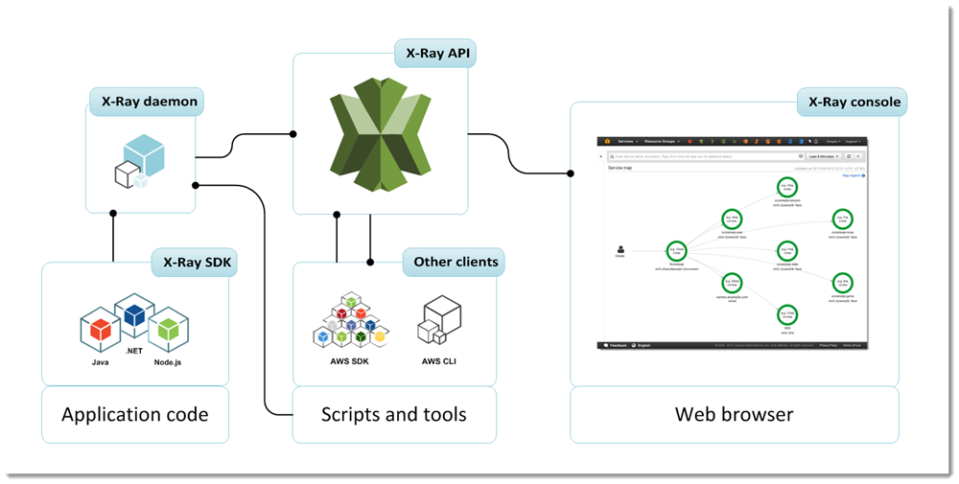
Drawbacks of Serverless
Vendor Control
Resource Limits
Debugging
Challenges

Slide 8
Walkthrough of a Sample Application

Slide 9
Summary
We learned:
How Serverless/FaaS came to be and what it’s about
Pros and cons of Serverless
Building a serverless application

